Slide 1
Data visualization for G20 countries Spending
Siqi jiang –GWU Data science

Slide 2
Overview
Data Source: Word Bank and OECD Database
G20 Countries (EU is excluded) ; Years Range: 2009 to 2016
HTML, JavaScript and Google Visualization APIs
Graphs and conclusions

Slide 3
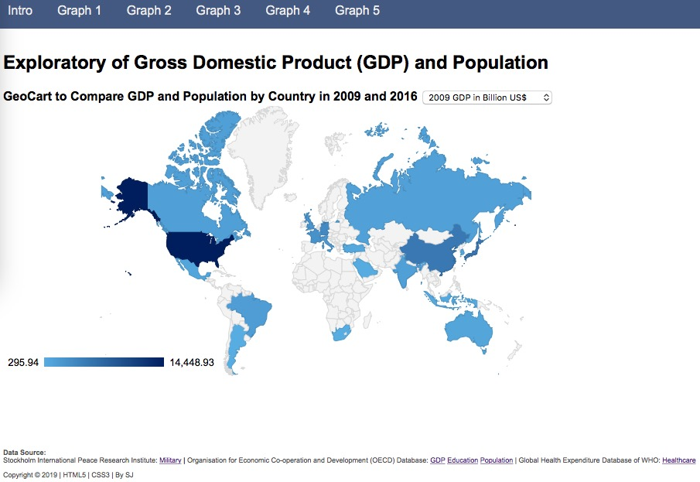
Graphs and conclusions (show in web page)

